Slide 1



Inhibition of Protein Phosphatase 5 (PP5) as Mechanism of ERK Pathway Activation in Systemic Lupus Erythematosus CD4+ CD28+ T Cells
Final Research Proposal
BIOL 6229
Gurmeet Kaur, Vaishali Jain, Mia Lin
Notes:
https://www.ncbi.nlm.nih.gov/nuccore/AE002098

Slide 2
Table of contents
01
02
03
04
05
06
07
Abstract & Introduction
Hypothesis & Aims
Aim 01 - Identify the effect of inhibitor and inhibitor levels on PP5 and Dnmt1 levels in Cd4+ CD28- T Cells
Aim 02 - Identify the effect of inhibitor and inhibitor levels on SLE gene expression levels in CD4+ CD28- T cells and compare them to healthy CD4+ CD28- T Cells
Aim 03 - Identify inhibitor effect on PP5, Dnmt1, SLE gene expression levels in CD4+ CD28- cells of SLE Animal Model
Timeline & Budget
Discussion & Challenges

Slide 3
01
Abstract & Introduction

Slide 4
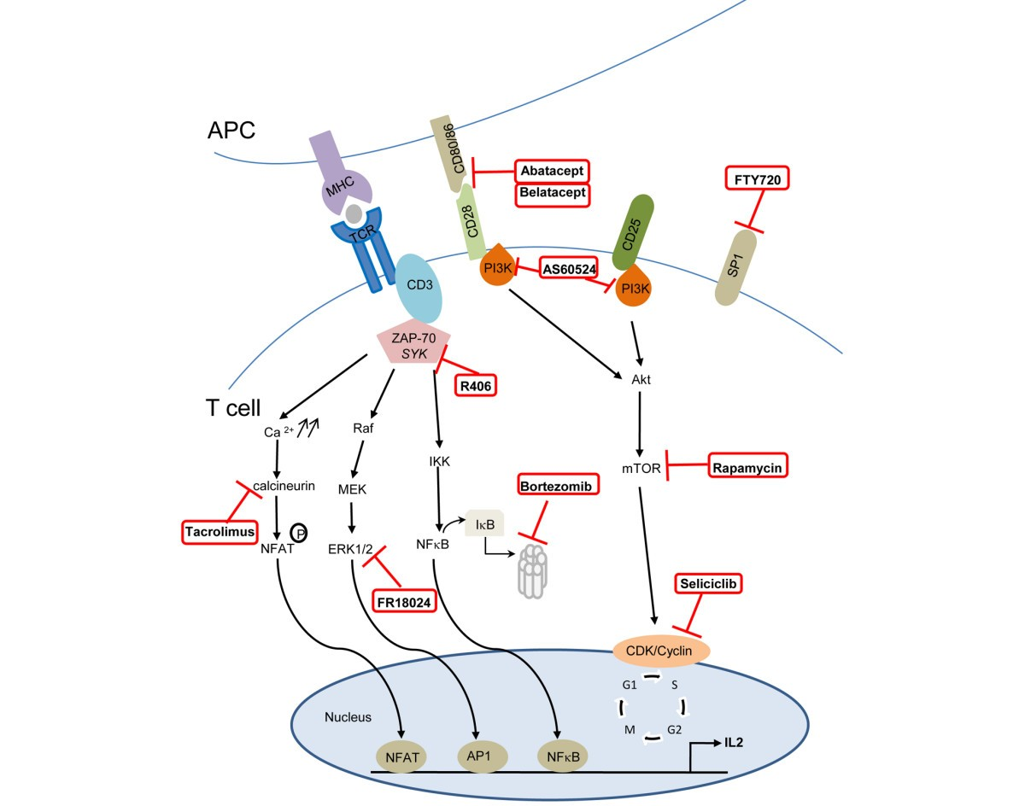
Abstract
Investigating PP5 inhibition in SLE pathogenesis and therapy due to disease complexity and therapy limitations (Chiswick et al., 2011; Patel et al., 2016).
Recognizing how PP5 affects the ERK pathway and gene regulation in SLE-affected CD4+ CD28- T cells (Chiswick et al., 2011; Patel et al., 2016).
Implementing a range of PP5 inhibitors and in vitro and in vivo models for a thorough examination (Chiswick et al., 2011; Patel et al., 2016; Wang et al., 2023).
Making use of techniques such as phosphatase activity tests, RT-PCR, cell separation, and culture (Patel et al., 2016; Wang et al., 2023).

Slide 5
Using flow cytometry and ELISA assays to measure SLE gene expression and cytokine secretion (Chiswick et al., 2011; Patel et al., 2016; Preglej et al., 2023).
With PP5 inhibition, expect decreased SLE gene expression, lower PP5, and higher Dnmt1 (Chiswick et al., 2011; Patel et al., 2016).
Handling limitations like animal model complexity and assay accuracy (Chen et al., 2022; Patel et al., 2016).
Stressing the importance of comprehending molecular mechanisms for the development of targeted therapies and better patient outcomes (Chen et al., 2022; Patel et al., 2016).

Slide 6
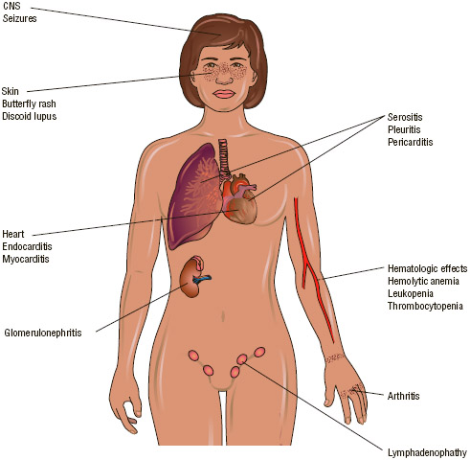
Introduction/Background
Women are more likely than men to have Systemic Lupus Erythematosus (SLE), a common autoimmune disease that primarily affects women of childbearing age (6–10:1)
SLE is influenced by both genetic and environmental factors; environmental triggers frequently cause the disease to begin (Mok & Lau, 2003).
SLE affects many different organs, but the central nervous system and kidneys are especially vulnerable (Borchers et al., 2010).
The hallmarks of SLE include immunological complex deposition, particularly in the kidneys, and autoantibodies directed against nuclear antigens.

Slide 7
DNA hypomethylation in CD4+ T cells and impaired ERK pathway signaling are factors in the pathogenesis of SLE (Gorelik & Richardson, 2010).
The need for individualized approaches to diagnosis and treatment is highlighted by the way that ethnic disparities worsen the outcomes of SLE (Piga & Arnaud, 2021).
The heterogeneity of the disease and the lack of validated biomarkers present challenges for novel therapies in clinical trials. By focusing on particular genetic and environmental factors, personalized medicine shows promise in treating the symptoms of SLE.
To enhance the management of SLE, an interdisciplinary approach is required, with a focus on therapy development, addressing ethnic disparities, and improving diagnostic techniques (Piga & Arnaud, 2021).

Slide 8
02
Hypothesis & Aims

Slide 9
Hypothesis & Aims
Primary Research Question: Can the Inhibition of PP5 lead to activation of ERK pathway and decrease expression of SLE genes?
Hypothesis: Inhibition of PP5 will activate the ERK pathway to decrease the expression of SLE genes.
Goal of Aims:
Confirming inhibitor activity on PP5, Dnmt1, and SLE gene expression levels
Best inhibitor & dosage for PP5 inhibition & decrease of SLE genes
In-vivo - mice models

Slide 10
03
Aim 01 - Identify the effect of inhibitor and inhibitor levels on PP5 and Dnmt1 levels in Cd4+ CD28- T Cells

Slide 11
Rationale
PP5 overexpressed in CD4+ CD28- T cells in SLE patients (Patel et al., 2016)
Increase PP5 associated with decrease in Dmnt
Dmnt 1 - replication of DNA methylation during mitosis in T cells
Inhibition of DNA methylation = Inflammatory cytotoxic cells
Hypothesis: Decrease in PP5 and increase in Dnmt1 with inhibitor
Notes:
Rationale/Hypothesis: PP5 levels & Dmnt1 levels should decrease with the addition of inhibitor
Research Question: Which inhibitor and dosage works the best in activating ERK pathway & decreasing expression of SLE genes?
PP5 known to decrease ERK & JNK pathway signaling (Patel et al., 2016)
Dnmt1 replicates DNA methylation during mitosis therefore T cells entering mitosis (Patel et al., 2016)
Decreasing Dnmt1 levels during mitosis inhibits the DNA methylation which causes T cells to become inflammatory cytotoxic cells seen in SLE
PP5 inhibitors have been studied as a cancer immunotherapy & immunotherapy
Inhibitors chosen
Cantharidin
Binds to phosphatase domain of PP5 & inhibit 4 constructs retaining phosphatase domain (Hong et al., 2016)
Utilized in cancer studies that induced apoptosis & supressed tumor growth (Hsieh et al., 2017)
Aurothioglucose
Inhibits by binding to phosphatase domain of PP5 similarly to Cantharidin (Hong et al., 2016)
N-oleoyldopamine
Inhibits by binding to phosphatase domain of PP5 similarly to Cantharidin (Hong et al., 2016)
Ro 90-7501
Binds to TPR domain of PP5 for inhibition (Hong et al., 2016)

Slide 12
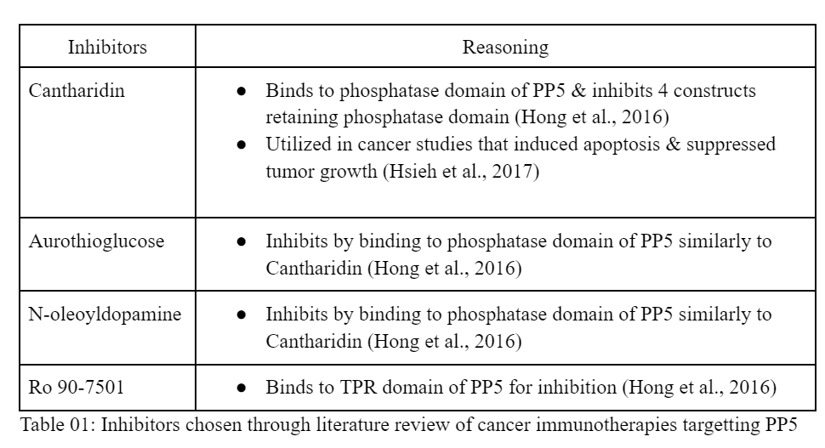
Rationale
Inhibitors used in cancer research
Never studied in SLE
Notes:
Rationale/Hypothesis: PP5 levels & Dmnt1 levels should decrease with the addition of inhibitor
Research Question: Which inhibitor and dosage works the best in activating ERK pathway & decreasing expression of SLE genes?
PP5 known to decrease ERK & JNK pathway signaling (Patel et al., 2016)
Dnmt1 replicates DNA methylation during mitosis therefore T cells entering mitosis (Patel et al., 2016)
Decreasing Dnmt1 levels during mitosis inhibits the DNA methylation which causes T cells to become inflammatory cytotoxic cells seen in SLE
PP5 inhibitors have been studied as a cancer immunotherapy & immunotherapy
Inhibitors chosen
Cantharidin
Binds to phosphatase domain of PP5 & inhibit 4 constructs retaining phosphatase domain (Hong et al., 2016)
Utilized in cancer studies that induced apoptosis & supressed tumor growth (Hsieh et al., 2017)
Aurothioglucose
Inhibits by binding to phosphatase domain of PP5 similarly to Cantharidin (Hong et al., 2016)
N-oleoyldopamine
Inhibits by binding to phosphatase domain of PP5 similarly to Cantharidin (Hong et al., 2016)
Ro 90-7501
Binds to TPR domain of PP5 for inhibition (Hong et al., 2016)

Slide 13
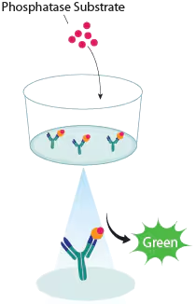
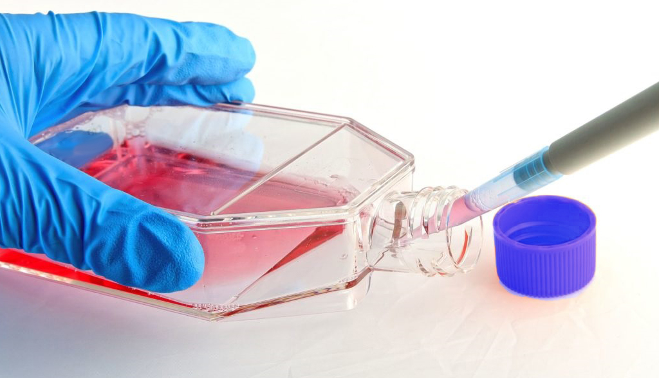
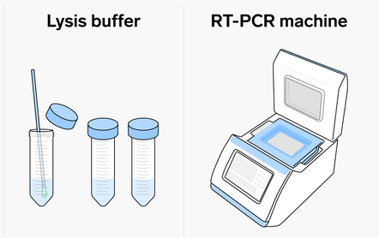
Methods
Cell Culture & Treatment
Separate CD4+CD28- T cells from PBMCs
Culture with 10% fetal calf serum added to RPMI 1640 medium
PP5 Inhibitors administered at different concentrations
RT-PCR: PP5 & Dmnt1
RNA extraction (untreated & treated) using kit
cDNA synthesis - reverse transcription
mRNA levels of PP5 & Dnmt1 measured & amplified
Phosphatase Activity Assay
Cell lysis via buffer
Add phosphatase substrate
Detect phosphate release via spectrophotometry
Notes:
Methodology:
Cell Culture and Treatment:
Context: It is common practice to isolate and cultivate T cells, then treat them with pharmacological inhibitors in order to investigate the effects of particular molecular pathways on cellular functions. Analogous techniques have been applied in earlier research to examine the regulatory functions of Dnmt1 and PP5 in T cell biology and autoimmune disorders (Patel et al., 2016).
Materials and Methods:
Cell Isolation: Negative selection will be used to separate CD4+CD28- T cells from peripheral blood mononuclear cells (PBMCs) (Patel et al., 2016).
Culture Conditions: 10% fetal calf serum added to RPMI 1640 medium will be used to cultivate isolated T cells (Patel et al., 2016).
Treatment: PP5 inhibitors, such as cantharidin, aurothioglucose, N-oleoyldopamine, and Ro 90-7501, will be administered to T cells. Treatment concentrations will be chosen in accordance with preliminary dose-response experiments and prior research (Patel et al., 2016).
Assessment of PP5 and Dnmt1 Levels (RT-PCR):
Context: Gene expression levels in biological samples can be measured using the widely used RT-PCR technique. The expression profiles of PP5 and Dnmt1 in a variety of cell types and disease states, including autoimmune disorders like lupus, have been examined in earlier studies using RT-PCR.
Materials and Methods:
RNA Extraction: Using a commercially available RNA extraction kit, total RNA will be extracted from both treated and untreated T cells (Patel et al., 2016).
cDNA Synthesis: Using a reverse transcription kit, reverse transcription will be carried out to transform RNA into cDNA (Patel et al., 2016).
RT-PCR Analysis: The mRNA levels of PP5 and Dnmt1 will be measured using quantitative real-time PCR (RT-PCR). We'll use PP5, Dnmt1, and housekeeping gene primers (like β-actin) for amplification. According to Patel et al. (2016), the relative expression levels of PP5 and Dnmt1 will be normalized to the expression levels of housekeeping genes.
Validation of PP5 Inhibition (Phosphatase Activity Assay):
Context: The enzymatic activity of phosphatase enzymes, such as PP5, is frequently evaluated using phosphatase activity assays. Similar assays have been used in earlier research to confirm that PP5 inhibitors are effective at preventing PP5 activity.
Materials and Methods:
Cell Lysis: A suitable lysis buffer will be used to lyse both treated and untreated T cells (Patel et al., 2016).
Phosphatase Activity Assay: A phosphatase activity assay kit will be used to measure PP5 activity in accordance with the manufacturer's instructions. In short, a phosphatase substrate will be added to cell lysates, and the amount of phosphate released will be detected using spectrophotometry. The PP5 enzymatic activity will be quantitatively measured by the assay (Patel et al., 2016).

Slide 14
Expected Results
Inhibitors will decrease PP5 and increase Dnmt1
N-oleoyldopamine
Lowest PP5 level & highest Dnmt1
Lower than 20% relative activity in PP5 (Hong et al., 2016)
Notes:
Anticipated Results & Limitations
Results
Expected that N-oleoyldopamine will have the lowest PP5 level and highest Dmnt1
Study showed a lower than 20% relative activity in PP5 using N-oleoyldopamine (Hong et al., 2016)

Slide 15
Limitations
Isolation of cells might include other cell populations
Culture condition variability affect interaction with PP5 inhibitors
Variations in RNA extraction efficiency
Variations in reverse transcription efficiency
Notes:
Limitations:
The process of isolating cells might not produce pure results; it might include different cell populations (Patel et al., 2016).
Cellular reactions to PP5 inhibitors may be impacted by culture condition variability (Patel et al., 2016).
Treatment efficacy may be impacted by variations in cellular responses to pharmacological agents (Patel et al., 2016).
RT-PCR results may be skewed by variations in RNA extraction efficiency (Patel et al., 2016).
Variations in reverse transcription efficiency could affect the measurement of mRNA levels (Patel et al., 2016).
Gene expression measurements may be impacted by variations in RT-PCR sensitivity and specificity (Patel et al., 2016).
A number of factors may have an impact on the phosphatase activity assay's reliability (Patel et al., 2016).

Slide 16
04
Aim 02 - Identify the effect of inhibitor and inhibitor levels on SLE gene expression levels in CD4+ CD28- T cells and compare them to healthy CD4+ CD28- T Cells

Slide 17
Rationale
Increased PP5 causes low Dnmt1 and decreased ERK pathway signaling
Overexpression of methylation-sensitive SLE genes and release of cytokines
Comparison to healthy CD4+ CD28- T cells reveal target gene levels & what inhibitor levels to achieve
Hypothesis: PP5 inhibitor will decrease SLE gene expression levels

Slide 18
Methods
Cell Culture & Treatment
Separate CD4+CD28- T cells from PBMCs
Culture with 10% fetal calf serum added to RPMI 1640 medium
Inhibition of PP5
Inhibitors at different concentration administer to cells in treatment groups
Control group will not receive inhibitors
Incubation
Stimulation and Intracellular Staining
PMA (phorbol 12-myristate 12-acetate) & ionomycin used to stimulate
Brefeldin A added to stop cytokine secretion
Fixation/Permeabilization Solution Kit used to identify markers of ERK & cytokines
Notes:
Methodology:
Cell Culture and Treatment:
Context: It is common practice to isolate and cultivate T cells, then treat them with pharmacological inhibitors in order to investigate the effects of particular molecular pathways on cellular functions. Analogous techniques have been applied in earlier research to examine the regulatory functions of Dnmt1 and PP5 in T cell biology and autoimmune disorders (Patel et al., 2016).
Materials and Methods:
Cell Isolation: Negative selection will be used to separate CD4+CD28- T cells from peripheral blood mononuclear cells (PBMCs) (Patel et al., 2016).
Culture Conditions: 10% fetal calf serum added to RPMI 1640 medium will be used to cultivate isolated T cells (Patel et al., 2016).
Treatment: PP5 inhibitors, such as cantharidin, aurothioglucose, N-oleoyldopamine, and Ro 90-7501, will be administered to T cells. Treatment concentrations will be chosen in accordance with preliminary dose-response experiments and prior research (Patel et al., 2016).
Assessment of PP5 and Dnmt1 Levels (RT-PCR):
Context: Gene expression levels in biological samples can be measured using the widely used RT-PCR technique. The expression profiles of PP5 and Dnmt1 in a variety of cell types and disease states, including autoimmune disorders like lupus, have been examined in earlier studies using RT-PCR.
Materials and Methods:
RNA Extraction: Using a commercially available RNA extraction kit, total RNA will be extracted from both treated and untreated T cells (Patel et al., 2016).
cDNA Synthesis: Using a reverse transcription kit, reverse transcription will be carried out to transform RNA into cDNA (Patel et al., 2016).
RT-PCR Analysis: The mRNA levels of PP5 and Dnmt1 will be measured using quantitative real-time PCR (RT-PCR). We'll use PP5, Dnmt1, and housekeeping gene primers (like β-actin) for amplification. According to Patel et al. (2016), the relative expression levels of PP5 and Dnmt1 will be normalized to the expression levels of housekeeping genes.
Validation of PP5 Inhibition (Phosphatase Activity Assay):
Context: The enzymatic activity of phosphatase enzymes, such as PP5, is frequently evaluated using phosphatase activity assays. Similar assays have been used in earlier research to confirm that PP5 inhibitors are effective at preventing PP5 activity.
Materials and Methods:
Cell Lysis: A suitable lysis buffer will be used to lyse both treated and untreated T cells (Patel et al., 2016).
Phosphatase Activity Assay: A phosphatase activity assay kit will be used to measure PP5 activity in accordance with the manufacturer's instructions. In short, a phosphatase substrate will be added to cell lysates, and the amount of phosphate released will be detected using spectrophotometry. The PP5 enzymatic activity will be quantitatively measured by the assay (Patel et al., 2016).

Slide 19
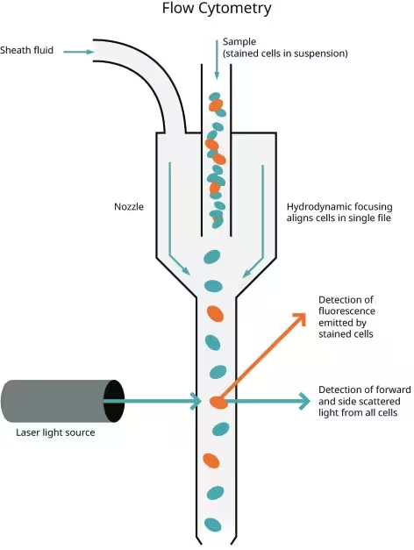
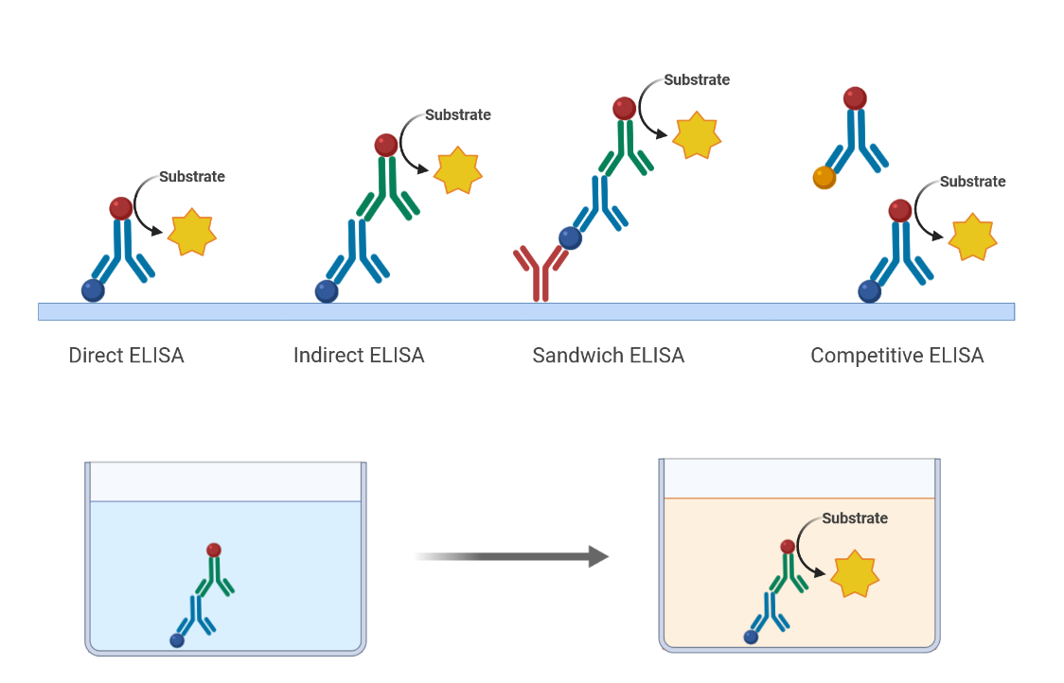
Methods
Flow Cytometry
Measures expression level of cytokines and markers of ERK pathway after staining
ELISA Assay
Measure secretion of cytokines associated with SLE in treated and untreated CD4+CD28- T cells
Compare treated groups and control group to see which inhibitor and dosage works best
Notes:
Methodology:
Cell Culture and Treatment:
Context: It is common practice to isolate and cultivate T cells, then treat them with pharmacological inhibitors in order to investigate the effects of particular molecular pathways on cellular functions. Analogous techniques have been applied in earlier research to examine the regulatory functions of Dnmt1 and PP5 in T cell biology and autoimmune disorders (Patel et al., 2016).
Materials and Methods:
Cell Isolation: Negative selection will be used to separate CD4+CD28- T cells from peripheral blood mononuclear cells (PBMCs) (Patel et al., 2016).
Culture Conditions: 10% fetal calf serum added to RPMI 1640 medium will be used to cultivate isolated T cells (Patel et al., 2016).
Treatment: PP5 inhibitors, such as cantharidin, aurothioglucose, N-oleoyldopamine, and Ro 90-7501, will be administered to T cells. Treatment concentrations will be chosen in accordance with preliminary dose-response experiments and prior research (Patel et al., 2016).
Assessment of PP5 and Dnmt1 Levels (RT-PCR):
Context: Gene expression levels in biological samples can be measured using the widely used RT-PCR technique. The expression profiles of PP5 and Dnmt1 in a variety of cell types and disease states, including autoimmune disorders like lupus, have been examined in earlier studies using RT-PCR.
Materials and Methods:
RNA Extraction: Using a commercially available RNA extraction kit, total RNA will be extracted from both treated and untreated T cells (Patel et al., 2016).
cDNA Synthesis: Using a reverse transcription kit, reverse transcription will be carried out to transform RNA into cDNA (Patel et al., 2016).
RT-PCR Analysis: The mRNA levels of PP5 and Dnmt1 will be measured using quantitative real-time PCR (RT-PCR). We'll use PP5, Dnmt1, and housekeeping gene primers (like β-actin) for amplification. According to Patel et al. (2016), the relative expression levels of PP5 and Dnmt1 will be normalized to the expression levels of housekeeping genes.
Validation of PP5 Inhibition (Phosphatase Activity Assay):
Context: The enzymatic activity of phosphatase enzymes, such as PP5, is frequently evaluated using phosphatase activity assays. Similar assays have been used in earlier research to confirm that PP5 inhibitors are effective at preventing PP5 activity.
Materials and Methods:
Cell Lysis: A suitable lysis buffer will be used to lyse both treated and untreated T cells (Patel et al., 2016).
Phosphatase Activity Assay: A phosphatase activity assay kit will be used to measure PP5 activity in accordance with the manufacturer's instructions. In short, a phosphatase substrate will be added to cell lysates, and the amount of phosphate released will be detected using spectrophotometry. The PP5 enzymatic activity will be quantitatively measured by the assay (Patel et al., 2016).

Slide 20
Expected Results
Inhibitors will decrease SLE gene expression levels
N-oleoyldopamine
Lowest PP5 level & highest Dnmt1 so likely lowest gene expression level
Lower than 20% relative activity in PP5 (Hong et al., 2016)
Notes:
Anticipated Results & Limitations
Results
Expected that N-oleoyldopamine will have the lowest PP5 level and highest Dmnt1
Study showed a lower than 20% relative activity in PP5 using N-oleoyldopamine (Hong et al., 2016)

Slide 21
Limitations
Results could be affected by each inhibitors off-target effects
Limitations of ELISA and flow cytometry in capturing all facets of T-cell biology can restrict applicability of findings (Chiswick et al., 2011; Preglej et al., 2023)
Notes:
Through BLAST, We looked at the section that sequenced for G protein and found a subsection of interest. We then utilized Primer Blast and found a primer set that would differentiate between HRSV A and B. The primer set is at an optimal length of 20 sequences, have a low level of self complementarity, has similar melting temperatures and a GC content of around 50%. The target sequence has been highlighted in yellow and the primer binding for Forward and reverse are highlighted in blue.

Slide 22
05
Aim 03 - Identify inhibitor effect on PP5, Dnmt1, SLE gene expression levels in CD4+ CD28- cells of SLE Animal Model

Slide 23
Rationale
Discover the effects of PP5 inhibition in SLE mice models
Inhibition studies would be carried out in vivo and the decrease in levels will be compared with healthy mice
The best inhibitor from previous studies will be utilized for this part of the study
Hypothesis: inhibitor administration to mice models where the human in vivo microenvironment can be mimicked will see a decrease in PP5, increase innDnmt1 and a decrease in SLE gene expression levels.

Slide 24
Methods
Creating SLE humanised animal model
Humanised immune system mice created to mimic human microenvironment and make studies accurate
Immunodeficiency has to be replicated with T and B cell interaction, skewed CD4 to CD8 ratio, IgG presence and anti ds DNA autoantibodies presence
Administering inhibitor to animal model
4-5 weeks old mice (untreated and SLE induced)exposed to inhibitors intraperitoneally and deaths will be monitored
Blood checked for autoantibody and cytokine presence in serum
Once mice sacrificed, mice kidney and spleen will be studies
Isolating CD4+ CD28+ cells from treated, untreated and healthy mice models
CD4+ CD28+ cells will be used to measure PP5, Dnmt1 and SLE gene expression levels
Negative selection used to separate CD4+ CD28+ from peripheral blood mononuclear cells (PBMCs)

Slide 25
Methods
Assessing PP5 and Dnmt levels with RT-PCR
RNA extracted and reverse transcribed
mRNA levels of PP5 and Dnmt1 measured using RT-PCR
PP5, Dnmt1 and housekeeping gene primers like 𝛃 actin for amplification where PP5 and Dnmt1 levels will be normalised to housekeeping gene expression level
Validating PP5 inhibition via phosphatase activity assay
PP5 enzymatic activity will be used to validate inhibitor activity
Cells will be lysed and phosphatase activity kit will be used. The resultant phosphate amount will be measured using spectrophotometry and PP5 enzymatic activity will be estimated quantitatively accordingly
Assessing SLE gene expression levels
ERK pathway activated to produce cytokines
Cytokine secretion stopped in the last 3 hours and intracellular staining performed to identify ERK pathway markers and SLE cytokines
Flow cytometry to check marker and SLE cytokine levels
ELISA to measure cytokine secretion levels

Slide 26
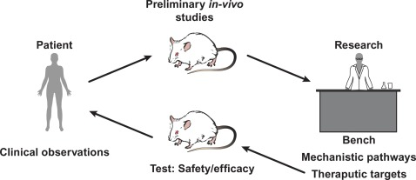
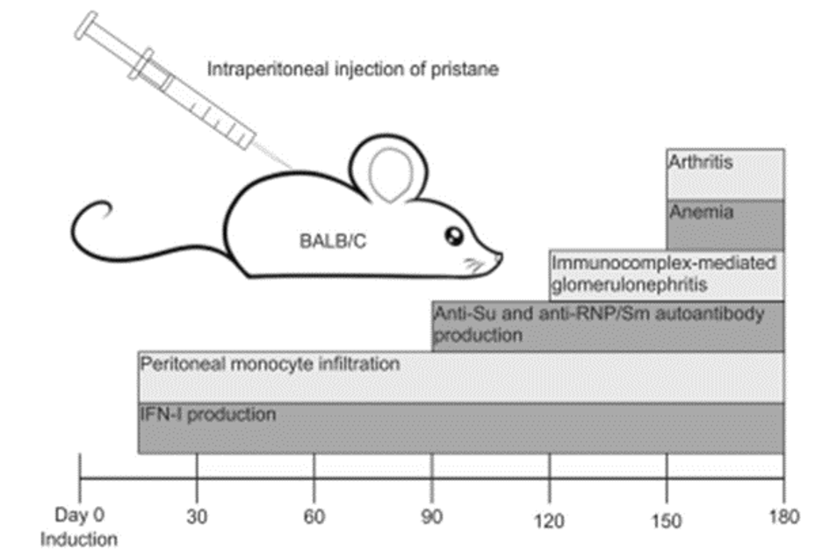
Expected Results
Addition of inhibitors will:
Decrease PP5 levels
Increase Dnmt1 levels
Decrease SLE expression genes in animal models
Healthy animal model and SLE animal model with inhibitor would have similar levels of PP5, Dnmt1 and SLE expression genes
Between untreated and inhibitor treated groups, the latter will have lower PP5 levels, higher Dnmt1 levels and lower SLE gene expression level

Slide 27
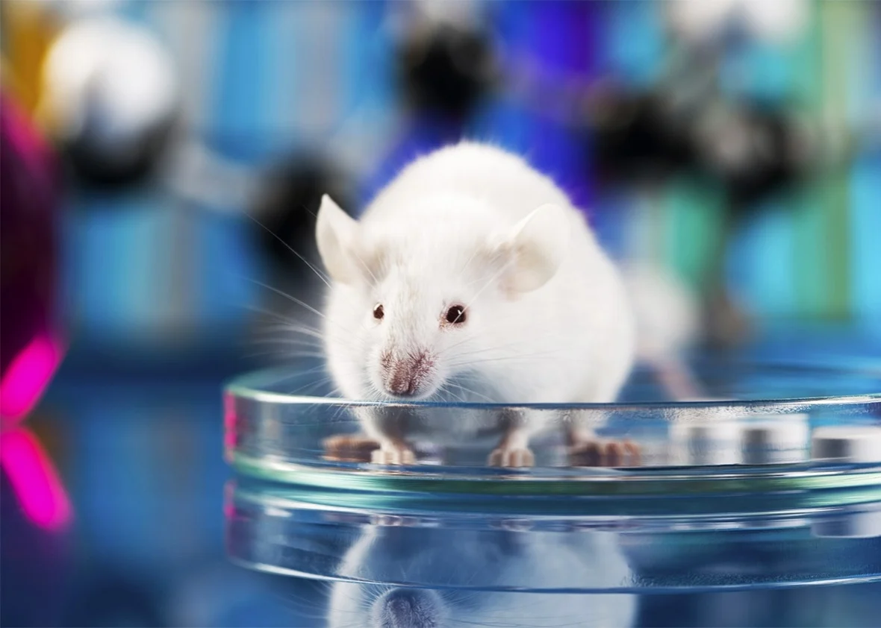
Limitations
Limited lifespan and survival rate of mice could affect the quality of study because of the short observation periods
Limited data obtained which might not be enough to take the studies to the next level i.e., in humans.
The data representation might not be accurate for humans since the disease might have problems being fully replicated in animals the way it is in humans.

Slide 28
06
Timeline & Budget

Slide 29
Timeline

Slide 30
Budget
Personnel Costs | Equipment and Supplies | Animal Model Costs | Travel and Conference Expenses | Publication Fees | Contingency Fees
Principal Investigator (PI) Research Assistants Postdoctoral Researchers Technicians Administrative Staff | Laboratory Equipment Consumables and Reagents | Humanized Mice Maintenance of Animal Facilities Veterinary Care and Monitoring Animal Feed and Bedding | Attendance at Scientific Conferences Travel for Collaborative Meetings | Open Access Publication Fees ($10,000 per year) | Unforeseen Expenses
$540,000 | $290,000 | $145,000 | $70,000 | $30,000 | $50,000
Grand Total Budget Proposal: $1,125,000

Slide 31
07
Discussion & Challenges

Slide 32
Discussion
Research into new treatments for SLE is necessary due to limited therapeutic options .
Novel therapeutics may improve knowledge of SLE pathways and provide additional treatment options
Inhibiting PP5 may reduce the levels of SLE gene expression, offering a potential therapeutic option.
Investigating PP5 inhibitors on SLE CD4+ CD28- T cells is supported by prior research.
Activation of PP5 deactivates the ERK pathway, which raises DNA methylation and decreases Dnmt1 levels, which in turn increases the expression of the SLE gene.
Further investigation into PP5 inhibitors may clarify their therapeutic potential for the management of SLE (Patel et al., 2016).

Slide 33
Challenges
Scheduling meetings in a remote learning environment when schedules and responsibilities differ.
Experience gave me insightful knowledge about adjusting to remote work settings.
The use of formatting guidelines made things more complicated.
Meeting submission requirements required close attention to detail and tool proficiency.
The significance of being meticulous and having skill with formatting tools in order to finish projects successfully.
An invaluable opportunity to gain experience managing obstacles and detours while finishing a project.

Slide 34
References
Chiswick, E. L., Duffy, E., Japp, B., & Remick, D. G. (2011b). Detection and quantification of
cytokines and other biomarkers. In Methods in molecular biology (pp. 15–30). https://doi.org/10.1007/978-1-61779-527-5_2
Patel, D., Gorelik, G., & Richardson, B. (2016). Protein phosphatase 5 contributes to the
overexpression of epigenetically regulated T-lymphocyte genes in patients with lupus. Lupus: Open Access, 01(03). https://doi.org/10.35248/2684-1630.16.1.120
Wang, T., Wei, L., Meng, S., Song, W., Chen, Y., Li, H., Zhao, Q., Jiang, Z., Liu, D., Ren, H., &
Hong, X. (2023). Coordinated priming of NKG2D pathway by IL-15 enhanced functional properties of cytotoxic CD4+CD28− T cells expanded in systemic lupus erythematosus. Inflammation, 46(5), 1587–1601. https://doi.org/10.1007/s10753-023-01860-z
Chen, J., Liao, S., Zhou, H., Yang, L., Guo, F., Chen, S., Li, A., Pan, Q., Yang, C., Liu, H., &
Pan, Q. (2022). Humanized mouse models of Systemic lupus erythematosus: opportunities and challenges. Frontiers in Immunology, 12. https://doi.org/10.3389/fimmu.2021.816956

Slide 35
Mok, C. C., & Lau, C. S. (2003). Pathogenesis of systemic lupus erythematosus. Journal of
Clinical Pathology, 56(7), 481–490. https://doi.org/10.1136/jcp.56.7.481
Borchers, A. T., Naguwa, S. M., Shoenfeld, Y., & Gershwin, M. E. (2010). The geoepidemiology
of systemic lupus erythematosus. Autoimmunity Reviews, 9(5), A277–A287. https://doi.org/10.1016/j.autrev.2009.12.008
Gorelik, G., & Richardson, B. C. (2010). Key role of ERK pathway signaling in lupus.
Autoimmunity. https://doi.org/10.3109/08916930903374832
Piga, M., & Arnaud, L. (2021). The main challenges in systemic lupus erythematosus: Where do
we stand? Journal of Clinical Medicine, 10(2), 243. https://doi.org/10.3390/jcm10020243

Slide 36
THANK YOU

